Slide 1
Global Suicide Rates A glimpse at geographic, global and Demographic trends
Data Analytics Bootcamp (T/Th Session)
Nireesha Abbineni
Mrinmayee Kulkarni
Allyssa Calhoun

Slide 2
Our process
We wanted to dive into an issue that had global significance. One that warranted a deeper look into trends, demographics, geographic analysis, and possible correlations
We were able to find the data we needed on Kaggle.com
https://www.kaggle.com/russellyates88/suicide-rates-overview-1985-to-2016
The dataset was compiled from four datasets:
United Nations Development Program. (2018). Human development index (HDI). Retrieved from http://hdr.undp.org/en/indicators/137506
World Bank. (2018). World development indicators: GDP (current US$) by country:1985 to 2016. Retrieved from http://databank.worldbank.org/data/source/world-development-indicators#
[Szamil]. (2017). Suicide in the Twenty-First Century [dataset]. Retrieved from https://www.kaggle.com/szamil/suicide-in-the-twenty-first-century/notebook
World Health Organization. (2018). Suicide prevention. Retrieved from http://www.who.int/mental_health/suicide-prevention/en/
The data was very comprehensive, however we did find a glitch in missing statistics for Baby Boomers in 2010.
We reported the flaw in the dataset to the Kaggle dataset.

Slide 3
Clean UP PRocess
Nireesha
Staged a cleaner version of source dataset upfront with the following cleansing measures
Standardized the column names. Few attributes have column names with leading spaces which makes it unfriendly for programming.
Removed the Duplicate records.
Extracted a 10 year subset from the raw dataset for baselining.
Augmented the data frame with additional computed columns
Totals by year
Totals by country

Slide 4
A global issue
Mrun
A look at global suicides over the last 10 years reveals the issue affects people everywhere
Insert visual here
Notes:
Insert a map of your country.

Slide 5
Top 3 Global findings from heat map
Mrun
Finding and data or stat to back it up
Notes:
Insert a picture of one of the geographic features of your country.

Slide 6
A deep dive into the top ten countries
Countries with the highest number of suicides
United States
Russian
Japan
South Korea
Germany
Brazil
France
Ukraine
Poland
Mexico

Slide 7

A wide spread issue
Observation and stat
#2
#3
Bar Graph
Notes:
Insert a picture illustrating a season in your country.

Slide 8

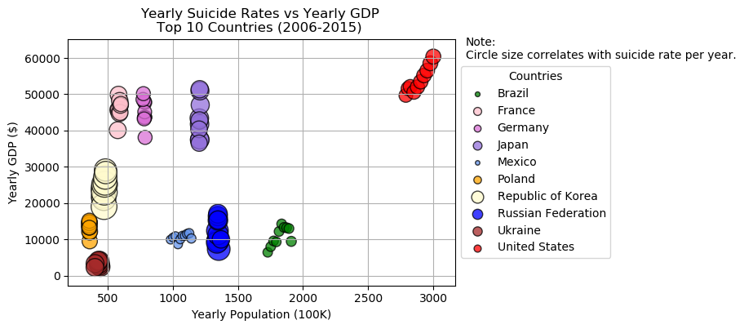
Correlation between GDP and Suicide Rates
We were interested to determine if there was a statistically reliable correlation between GDP and Suicide Rates
Hypothesis was that richer the country, greater the rate
Based on Maslow’s Hierarchy of Needs
Fact: Hypothesis true? – Not True
Consistent Bubble sizes for most countries indicate there are no noticeable suicide rate hikes even if GDP increased from year to year
Korea and Russia show a slight correlation
The current dataset may not be sufficient for a deeper analysis to provide more insights into the correlation of these dimensions
Notes:
Insert a picture of an animal and or plant found in your country.

Slide 9
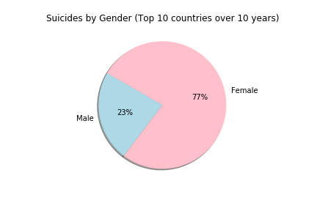
A look at gender disparity—(top 10)
We were surprised how much more prevelant suicide was among females
Females accounted for 77% of all
suicides
None of the top 10 countries were significantly more lopsided than others
Notes:
Add key points in the history of your country to the timeline.

Slide 10
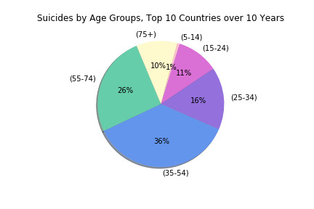
Are certain age groups more susceptible to suicide than others?
The 35-54 age group accounts for the largest segment to succumb to suicide
Perhaps because this is the age where we feel the strongest pressures financially, career-wise, and maritally
At first glance, the 75+ group, comprising 10% of all suicides was surprising
A cursery look at other research suggest a terminal health diagnosis link to be primary cause among this age group
The saddest finding was the 10K children in the (5-14) bracket
Notes:
Insert a picture illustrating a custom or tradition here.

Slide 11
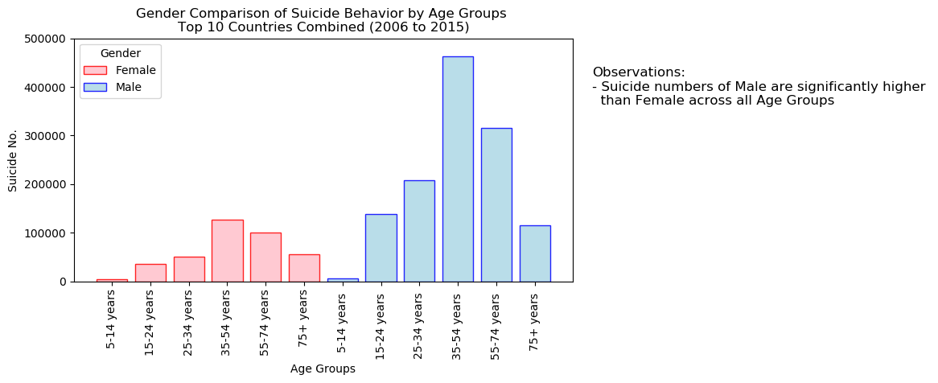
GENDER Comparison across age groups
A histogram of Male and Female suicide counts across the 6 age buckets show significantly higher numbers among the Male compared to Female.
The disparity between 35-54 year Male and Female suicide rates is much higher than other buckets.
Notes:
Insert a picture of the head leader of your country.

Slide 12
United States

Slide 13
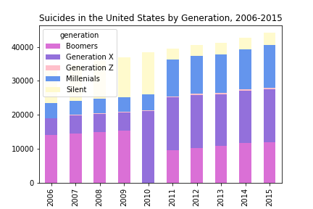
Suicides in the US by Generation
Gen Xers warrant a deeper dive into life stressers and mental issues in that generation
Part of the increase can be explained by them moving into the most dangerous age group for suicides, (35-54)
Numbers are especially alarming when this generations has 15 year birthyear span vs. some of the others (up to 21years)
The data appears to follow 2 separate trend lines. One from 2006-2010 and the other from 2011-2015
Perhaps separate original source datasets were used to compile original dataset
Notes:
Insert a picture that illustrates some part of your country’s economy.

Slide 14
Statistical Analysis
Any statatistcal analysis info here
Notes:
Insert a picture of one of the points of interest for your country.

Slide 15
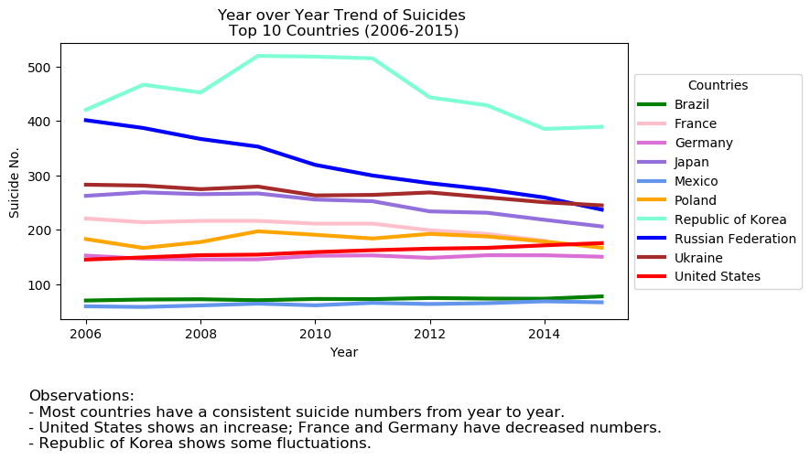
Conclusions
All
We found the top 10 countries with higher suicide rates and their trends from 2006 - 2015.

Slide 16
Conclusions
All
Dataset limitiations found
Current dataset does not have the attributes for a deeper insights such as Household Income, Behavioral, Social impact analysis
Data Analytics Learnings

